Slide 1



CHAPTER 1
AI TOOLS
AND
PROMPT ENGINEERING

Slide 2

INTRODUCTION TO AI
  AI stands for Artificial Intelligence
  Artificial means Human generated and Intelligence means Smart
  AI is nothing but Artificial Intelligence which convert normal machine into smart machine by adding the ability to think like human.
Normal Machine = Machine that do not have thinking ability
  Eg: washing machine, normal bulb, fans, computers
  It is also called as Non-AI oriented machine
Smart Machine = Machine that have thinking ability like human.
  Eg: Alexa, Siri
  It is also called as AI oriented machine

Slide 3

Human Intelligence
Human Intelligence is the ability of humans to think, learn, understand, solve problems, make decisions, and use experience in daily life.
  Can think and reason.
  Learns from experience and mistakes.
  Understands emotions and feelings.
  Can be creative and generate new ideas.
  Makes decisions based on knowledge and judgment.
Guess The Emojis
Example:
A student learns from a mistake in a test and studies differently for the next exam. This is an example of Human Intelligence.

Slide 4
Safe Search Method
  Ask learning-related questions only
  Do not share personal information
  Use respectful and appropriate language
  Check important information
  Ask an adult if something feels wrong

Slide 5
Why AI not Always Correct??
AI learns from large amounts of data, but it does not truly understand information like humans do.
Reasons AI Can Be Wrong:
  AI may use incorrect or outdated information.
  AI cannot think or reason like humans.
  AI may misunderstand a question.
  AI sometimes makes up answers. This is called AI Hallucination.
What is AI Hallucination?
AI Hallucination happens when AI gives information that sounds correct but is actually wrong or made up.
Example: AI says a book was written by a certain author, but in reality, that author never wrote the book.
Important Key Rule: Always verify important AI answers with your teacher, textbook, or trusted sources.

Slide 6
ACTIVITY
  Where we used AI in day-to-day life
  Can AI solve your difficult Math problems
Key Terminologies of AI
Data: Data is a collection of facts, numbers, images, words, or information that can be used to learn something.
Dataset: Set of data (Training + Testing)
Training Data: Data given to AI to train their brain
Testing Data: Data given to AI to test their brain
Algorithm: A set of steps or instructions that a computer follows to solve a problem. It is used to train the Brain of AI
Prediction: Generated Result or output guess by AI

Slide 7
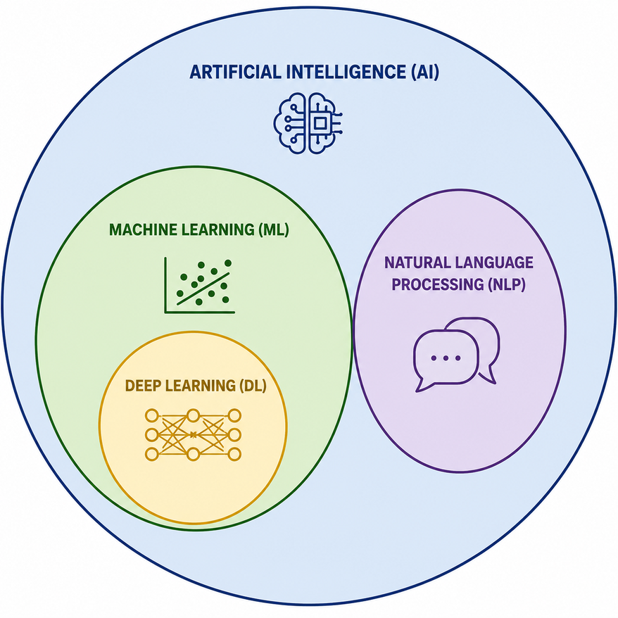
Subset Of AI
In previous slides we learned about AI
Now Let’s shortly understands what are the subset (subfield) of AI
  Machine Learning : AI that allows computers to learn from data (Deep Drive-in next slide)
  NLP : It stands for Natural Language Processing which allows AI to understand the Human Language like slang, phrases and proverbs. (Deep Drive-in next slide)

Slide 8
Machine Learning
Machine Learning is a type of AI that allows computers to learn from data and improve automatically without being specifically programmed every time.
  Learns from examples and data.
  Improves performance with experience.
  Finds patterns in information.
  Helps computers make predictions and decisions.
  Becomes smarter as more data is provided.
Activity: 2, 3, 5, 7, 11, ??

Slide 9
Natural Language Processing
Natural Language Processing (NLP) is a branch of Artificial Intelligence (AI) that helps computers understand, read, write, and respond to human language like English, Hindi, or Marathi.
  NLP finds keywords in your text
  NLP understand the language which you speak and give answer in that language
  Google Assistant, Siri, Alexa, or ChatGPT understands your question and gives you an answer.
Activity: Identify the keyword
I want to go to school
AI is the machine that have ability to think like human

Slide 10
How AI learn From Examples??
  It is shown many input–output examples (training data)
  It finds patterns and relationships in the data
  It builds a model based on those patterns
  When new data comes, it predicts the output using what it learned
  The more examples it sees, the better it gets at predicting

Slide 11
NotebookLM
  It is an AI-powered note-taking and research tool by Google
  Helps you understand and summarize your documents
  You can upload PDFs, Google Docs, notes, and text files
  It creates an AI assistant based only on your uploaded content
  You can ask questions from your documents
  It gives summaries, explanations, and key points
  It helps in studying, research, and content writing
  It reduces time spent on reading long documents
  Responses are based on your sources, so it is more focused and reliable

Slide 12
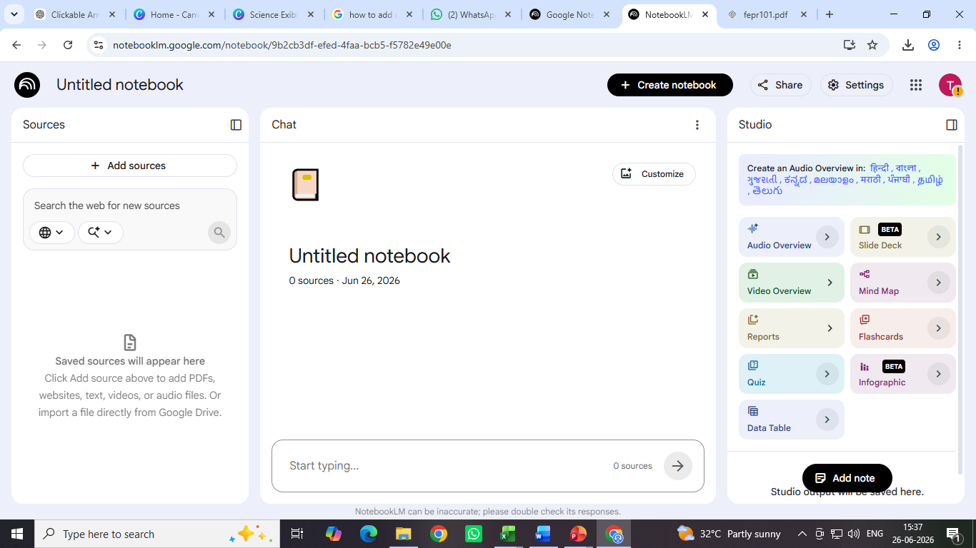
NotebookLM
Get output from below tabs
Add Your Source here

Slide 13
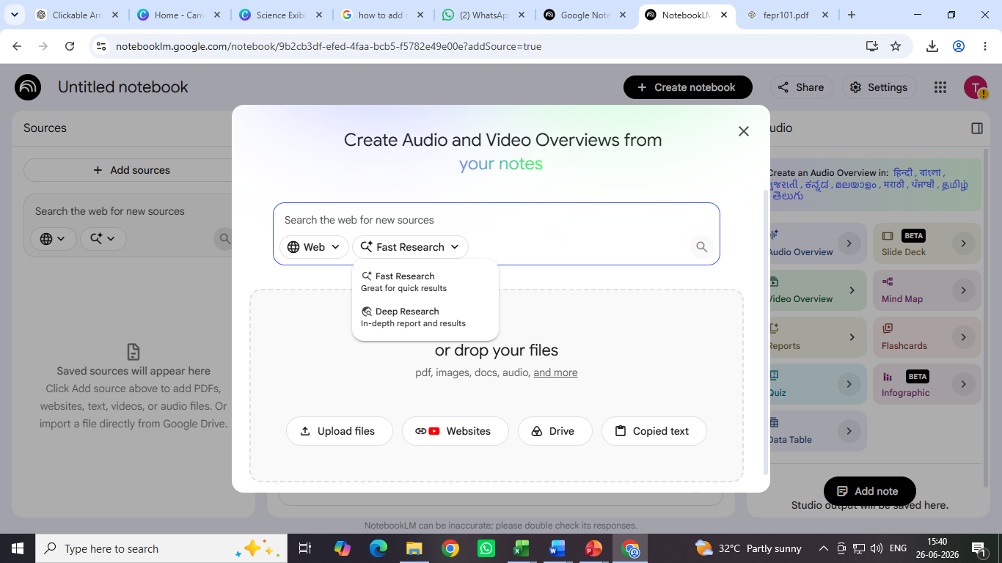
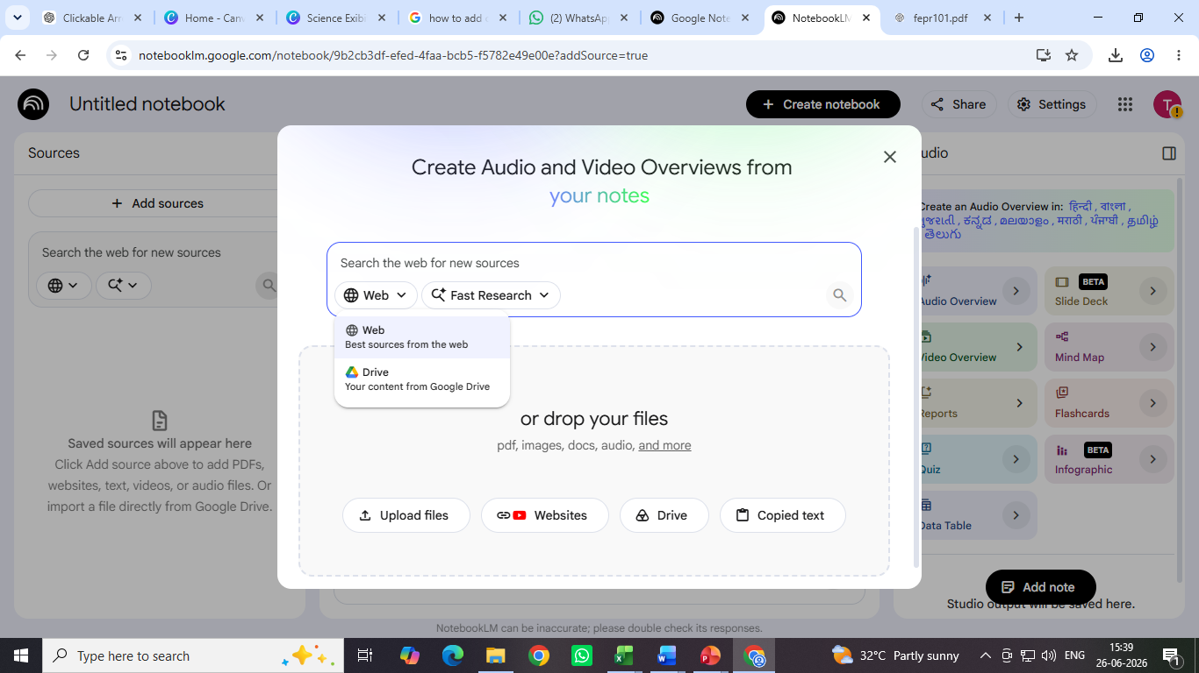
NotebookLM
Fast or Deep Research
Give sources as Websites
Upload personal material

Slide 14
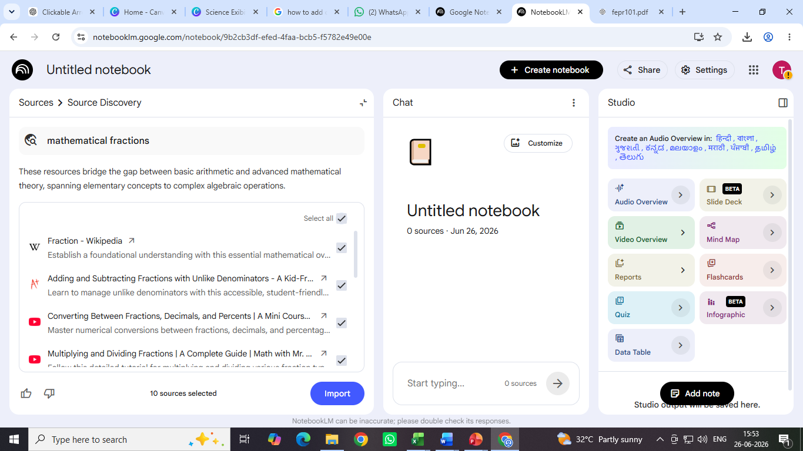
NotebookLM
You can control your source here and import only reputed websites to create quiz, summary, podcast etc

Slide 15
Gamma
  Gamma is an AI-powered presentation tool that helps users create professional presentations, documents quickly using simple text prompts.
  Features
  AI creates presentations automatically.
  Professional templates and designs.
  Adds images and layouts automatically.
  Saves time and effort.

Slide 16
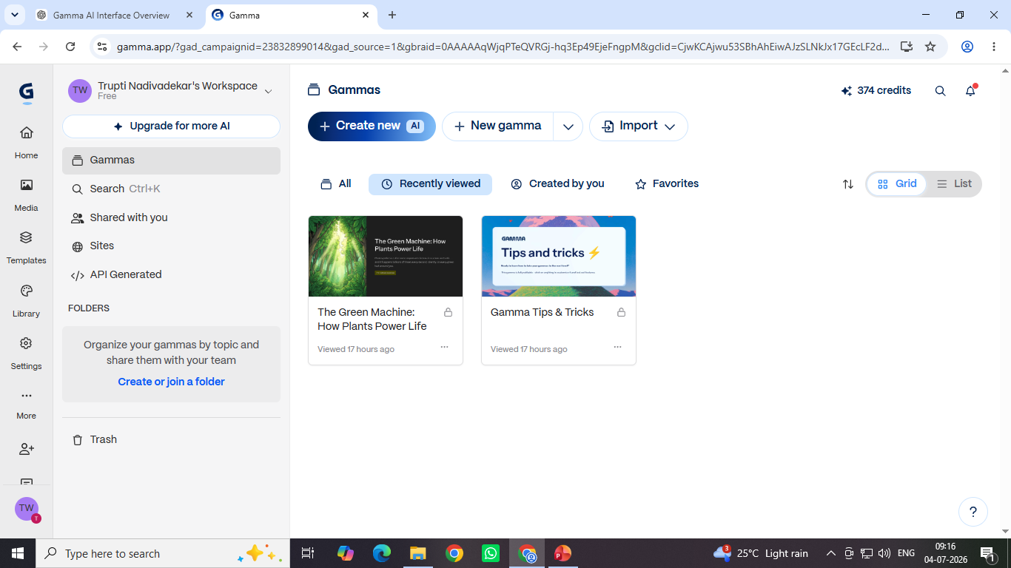
Gamma Interface
You can get readymade templates, Media etc
Import your resources from your computer or any file/website online
Create New gamma
Create your PPT based on cards. Instead of slides gamma uses cards

Slide 17
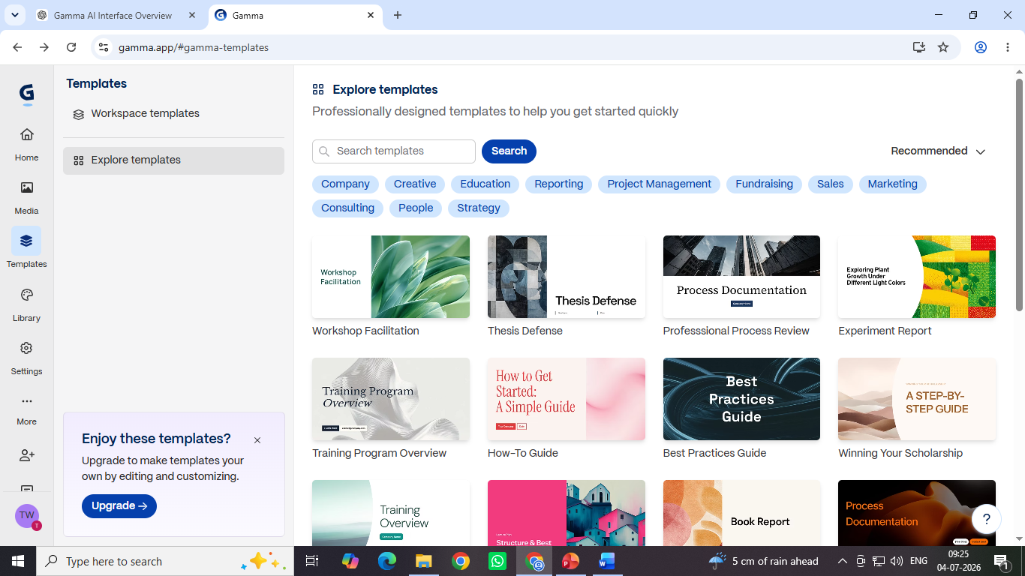
Gamma Interface
Here you will get readymade PPTs. You can select and edit it as per your requirement

Slide 18
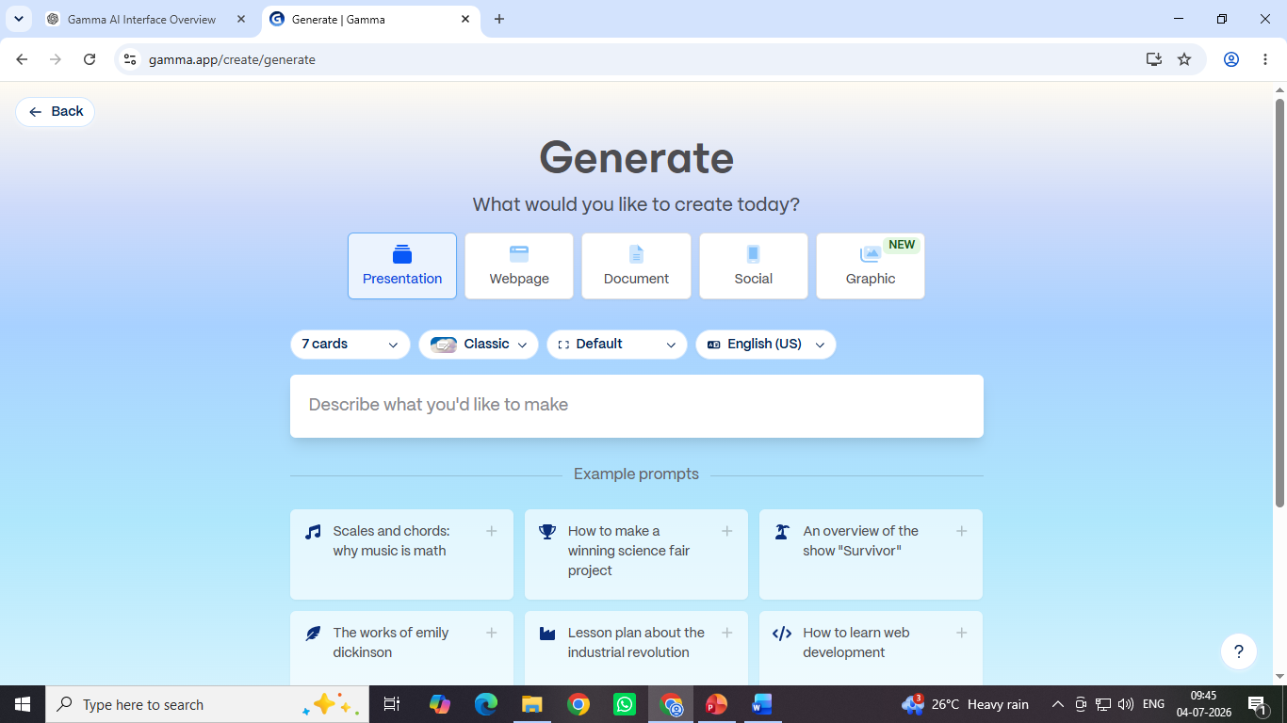
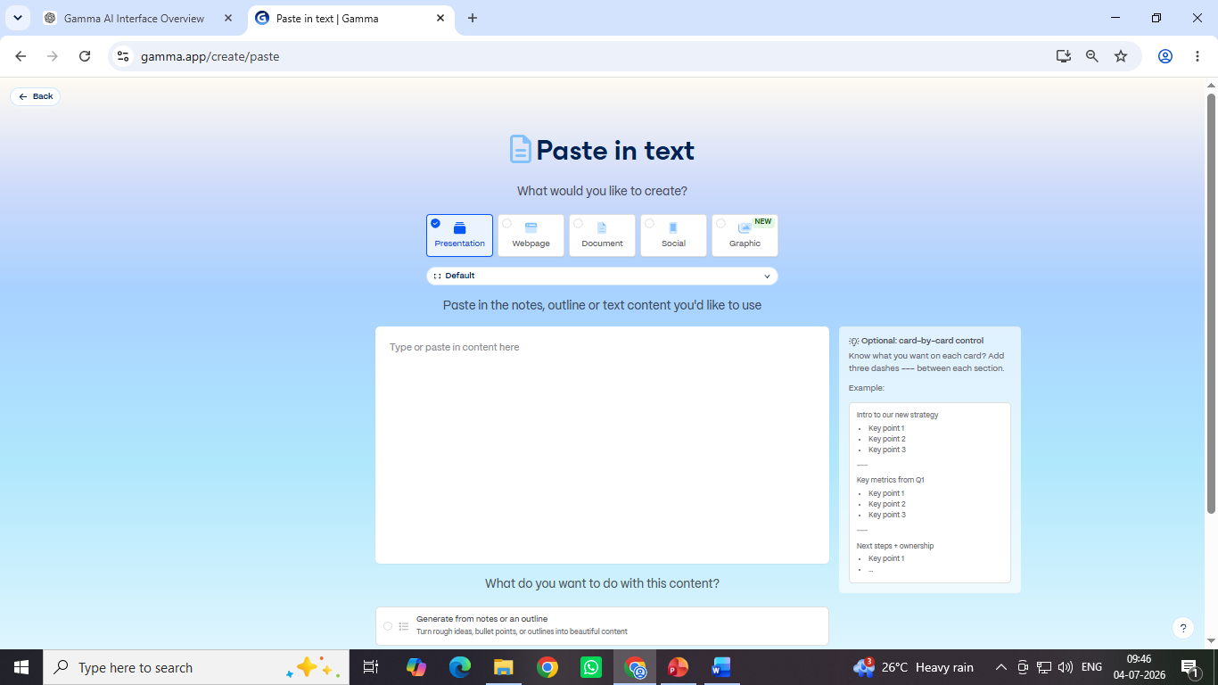
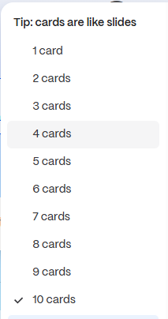
Gamma Interface
You can control your cards content with “---” and gamma will create ppt as given prompt
Select no. of cards and with one prompt you can create
PPT

Slide 19
Introduction To LLM
LLM stands for Large Language Model.
  Large → Trained on huge amounts of data and contains billions of parameters.
  Language → Works with human languages like English, Hindi, Marathi, etc.
  Model → A mathematical system that learns patterns from data.
  It is a type of Artificial Intelligence (AI) that understands and generates human language.
  It is trained on a very large amount of text data such as books, articles, websites, and documents.
  Examples include ChatGPT, Gemini, and Claude.
How LLM works :
  It reads large amounts of text during training.
  It learns patterns, grammar, facts, and relationships between words.
  When a user enters a prompt, it predicts the most likely next words.
  It generates a complete response based on those predictions.

Slide 20
Introduction to Prompt Engineering
  Prompt is nothing but the effective way to provide the instructions to the AI tools.
  Prompt Engineering is the study of writing the effective prompts for AI tools which helps to provide the effective output or results.
Weak Prompt = A unclear instruction that gives poor results.
Eg: Tell me about AI
Strong prompt: A clear, specific instruction that gives better and accurate results.
Eg: Explain Artificial Intelligence in 5 simple points for beginners with examples
ACTIVITY:
1.Open Google AI tool
2.Search “Tell me about LLM” and review the generated results
3.Now search “Tell me about a LLM in 6–7 lines including example and use in real world scenario” now see the difference.

Slide 21
Types of Prompts
1. Role-based Prompt = A prompt where you assign a role or identity to AI so it responds like that expert or person.
Eg: “You are a teacher. Explain photosynthesis in simple words.”
2. Task-based Prompt = A prompt where you clearly give a specific task or instruction without assigning any role.
Eg: “Explain photosynthesis in simple words.”
ACTIVITY:
  Give above examples prompts in Google AI tool
  Give the weak prompts and convert it into strong prompts
  Give the example of Role-based and Task-based prompts

Slide 22
RTF Framework (Role – Task – Format)
RTF stands for Role Task Format.
Role: Who should AI act as?
Task: What should AI do?
Format: How should the answer be presented?
Features of RTF Framework:
  Easy framework for everyday prompting.
  Ideal for beginners and professionals.
Example:
Role: HR Manager
Task: Create a Job Description
Format: Bullet points with salary, responsibilities, and qualifications
Prompt Example: Act as an HR Manager. Create a job description for a Sales Executive. Present it in bullet points including salary, responsibilities, and qualifications.

Slide 23
Chain Prompting
It divides a large task into smaller prompts.
Each response becomes input for the next prompt.
It produces more detailed and accurate results.
It is ideal for complex projects.
Example of Chain Prompting:
Business Idea → Business Plan → Website Content → Social Media Posts → Email Marketing
Iterative Prompting
Improve responses step by step.
Refine instead of rewriting from scratch.
Add new instructions after each response.
Produces polished final results.
Example of Iterative Prompting:
Prompt 1: Write a resume. Prompt 2: Make it more professional.
Prompt 3: Reduce it to one page. Prompt 4: Optimize for HR role. Prompt 5: Add ATS-friendly keywords.

Slide 24

ACTIVITY: Create the similar video using AI
PROMPT USED: Boy wins the running race
VIDEO:
Video Generation Using AI

Slide 25
Mini Project Using AI Tools
Create a revision notes using NotebookLM AI based on your school syllabus

Slide 26
DONE WITH MODULE 1
ANY DOUBTS ???

Slide 27
CHAPTER 2
BASICS OF PYTHON PROGRAMMING

Slide 28
INTRODUCTION TO PYTHON
  Python is general-purpose high-level scripting and programming language
  The Python was developed by Guido van Rossum in year of 1991.
  Python is Beginner Friendly Programming Language.
  Python is case sensitive language.
  Python file is stored with extension of .py
  Advantages:
    Python is open source and easy to use programming language
    Python have extensive library function
    Python is dynamically typed and interpreted
    Python is platform independent
  Disadvantages:
    Python is slow to execute compared to C, C++, Java
    Python security depends on the programmer and application design

Slide 29
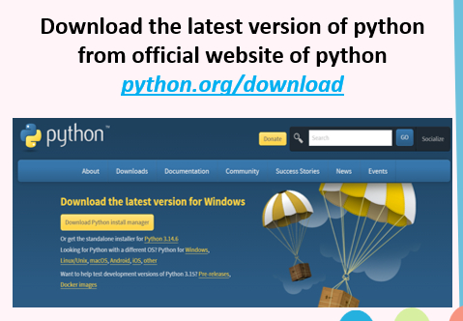
  8.Application:
a. Python is applicable in website, desktop App, Web App, Android App development
b. Python is used in Data Analysis, Data Science, and Visualization
c. Python is used in Game Development, Machine Learning, Insight Generation
SETUP OF PYTHON

Slide 30
DATATYPES IN PYTHON
There are some important datatypes used in Python Program
  int: It defines integer data present in the program. Example: 6 , 3 , -24 (Whole Number)
  float: It determines decimal values in the program. Example: 16.90 , 14.12 , 12.00 , -32.89 , etc (Real Number)
  bool: It defines the Boolean data in the Program (True / False). It is also called as categorical data. Example: True , False.
  str: It is String. It is collection of words or characters enclosed in ‘ ’ or “ “.
How to Check Datatype of any Value:
type(): It is the Inbuilt function in python used to check type of data
Syntax: type( value )
Example: type(47) = int
Activity : Check the type of data 31, 3.78 , False , “Hii” , “False” , True , “True”

Slide 31
VARIABLE IN PYTHON
  It is a place where we can store the value
  We can give any name to variable like any word or character but we need to follow some rules.
Rule to Assign Variable Name:
1. Must start with a letter or underscore (_)
2. Cannot start with a number
3. Can contain letters, numbers, and underscores (_)
4. No spaces are allowed
5. Do not use Python keywords as variable names
ACTIVITY: Tell correct variable name
Student name , _id , School_Name, 12 , age12, 12age, age 12, _, if

Slide 32
KEYWORDS IN PYTHON
Keywords are the special words in python which having there own predefined functionality.
There are 32 keywords in python.
1. To get all keywords we need to use below program:
import keyword
keyword.kwlist
2. There are 3 special keyword: True , False , None
3. Why They are special, because we can assign it as value to a variable.
Activity: Print all Keyword using above program
Activity: Tell Right / Wrong: if = 2 , A = “if” , B = True , B = true

Slide 33
INPUT OUTPUT FUNCTION
There are two functions which helps to perform Input and Output in Python Program
  print() : It is inbuilt function in Python which is use to show statement to the screen. Which is the output statement
Syntax: print(“ text that we want to print ”)
Example: print(“Hello World”)
  input() : It is the inbuilt function in Python which is use to take the input from the user.
Syntax: variable_name = input(“text to help user what need to enter”)
Example: age = input(“Enter Your Age: ”)
Activity: Take Name and age from user and print it again

Slide 34
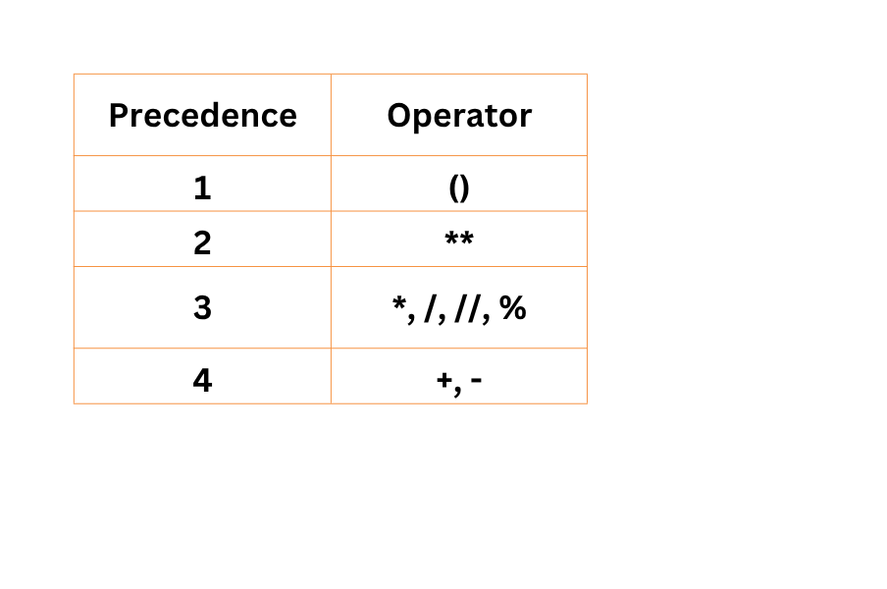
ARITHMETIC OPERATORS
It is use to perform specific arithmetic operation
  Addition (+): use to add numbers
  Subtraction (-): use to subtract numbers
  Multiplication (*): use to multiply number
  Normal Division (/): use to divide number
  Floor Division (//): It divide the number and return the integer part of division
  Modulus Division (%): It return the reminder of the division
  Power (**): use to find the power of number
ACTIVITY: Find answer 3**4+(4*2)-16/4%2//2
Hint: Use knowledge of Operation Preference

Slide 35
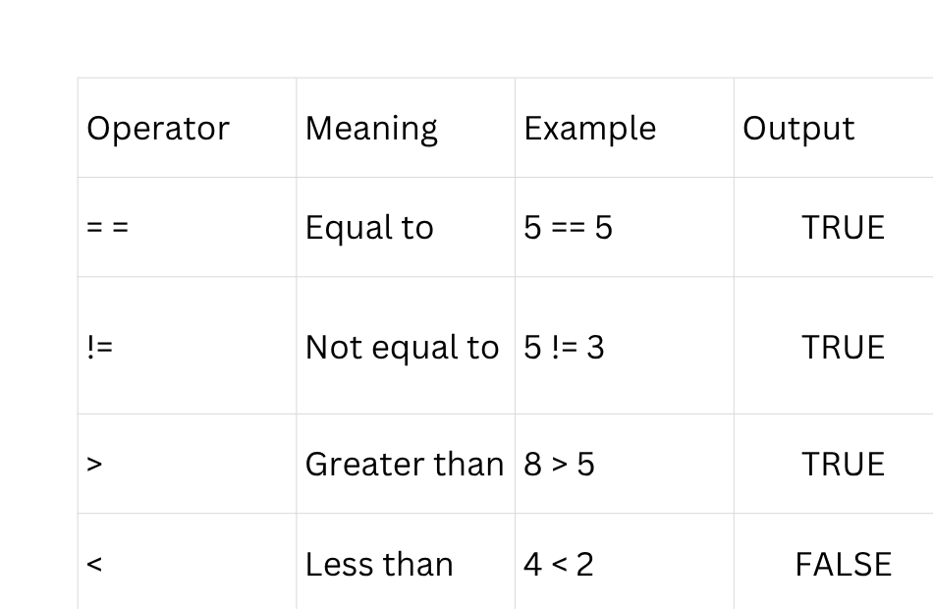
COMPARISON OPERATORS
It is used to compare LHS and RHS
There are different comparison operators
ACTIVITY:
Tell True OR False
  56 > 78
  -67 > 67
  0 == 0
  12 >= 12

Slide 36
ASSIGNMENT OPERATORS
It is used to assign a value to a variable
ACTIVITY: Assign below value and print it
  a = 3
  b = -56
  k = “constant”
There are two types in assignment operator
  Normal Assignment: Same like above (a = 3)
  Compound Assignment: It is used to update the looping variable.
Eg: a = a + 1 Here If a = 5 then in next loop a become 6
Note: We can write a = a + 1 as a += 1 both give same results.
Compound Assignment allows all type of operators.

Slide 37
CREATE YOUR OWN CALCULATOR
ACTIVITY: Create Simple Calculator in Python takes input from user
Inputs: Num1 , Num2 , Operation (+,-,*,/)
Code:
num1 = int(input(“Enter 1st number”))
num2 = int(input(“Enter 2nd number”))
addition = num1 + num2
sub = num1 - num2
mul = num1 * num2
div = num1 / num2
print(addition)
print(sub)
print(mul)
print(div)

Slide 38
CONDITIONAL STATEMENT
These Statements is executed when specific condition is true
  if : If a certain condition is true then this statement will execute
Syntax: if <condition>:
True Statement Block
Example: if age >= 18:
print(“You are eligible to vote”)
2. if else: It is extension of if where if condition is not true then else block will execute
Syntax: if <condition>:
True Statement Block
else:
False Statement Block
Example: if age >= 18:
print(“You are eligible to vote”)
else:
print(“You are not eligible to vote”)
ACTIVITY: CHECK THE STUDENT IS PASS OR FAIL MORE THAN OR EQUAL TO 32 MEANS PASS

Slide 39
3. if elif else: It is used when we have to check more than one condition in the
program
In if elif else statement if block is mandatory whereas else block is optional
We have to think when we need to use if else block and if elif else block
Syntax: if <condition 1>:
True Statement Block 1
elif <condition 2>:
True Statement Block 2
elif <condition n>:
True Statement Block n
Note: Every elif block should have condition
Passing else block is totally up to you, You should think about whether else
block is required or not.
Example: marks = 75
if marks >= 90:
print("Grade A")
elif marks >= 75:
print("Grade B")
elif marks >= 50:
print("Grade C")
else:
print("Fail")

Slide 40
LOOPING STATEMENT
A loop is a programming statement that repeats a block of code multiple times until a condition is met.
There are two looping statements:
1. for loop: A for loop is used when we know how many times we want to repeat a task.
Syntax: for variable in range(number):
# Code to repeat
Example: for i in range(5):
print("Welcome")
2. while loop: A while loop repeats the code as long as a condition is True.
Syntax: looping variable declaration
while condition:
# Code to repeat
Updating the looping variable
Example: count = 1
while count <= 5:
print(count)
count = count + 1

Slide 41
RANGE( ) FUNCTION
It is the Inbuilt python function used to get the numbers / data in a particular order
Mostly range ( ) function used in the for loop
Syntax: range( Start , End , Updation ):
Here Start is starting value i.e. where we want to start
End is where we want to end (End value not included in printing)
Updation is gap between two consecutive values.
Example: for i in range(1,50,1):
print(i)
ACTIVITY: Print even number from 1 to 100
Print odd number from 1 to 100
Print table of 8

Slide 42
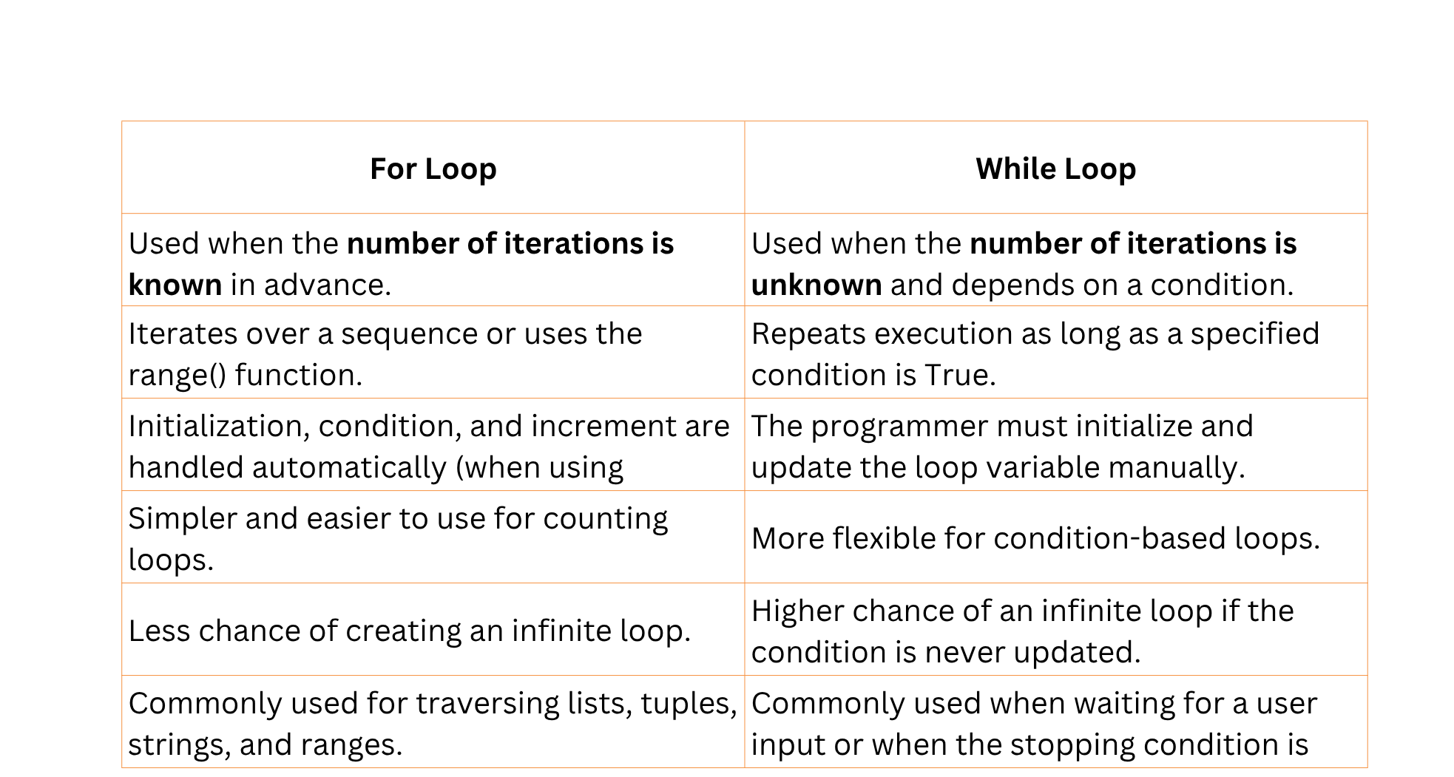
DIFFERENCE BETWEEN FOR AND WHILE LOOP

Slide 43
LIST IN PYTHON
  It is one of the multivalue datatype in Python i.e. it consists multiple value
  By using list, a single variable can able to store multiple value in the form of list
  list elements are enclosed in [ ] and separated by comma ‘ , ’
  Syntax of list: var_name = [ val1 , val2 , val3 , val4 , val5 ]
  List is the collection of homogeneous and heterogeneous elements.
Eg: list1 = [ 2 , “Rahul” , 14 , “Thane” , True ]
  homogeneous means elements with same datatype like in above example 2 , 14 both are int.
  heterogeneous means elements with different datatype like in above example 2 , “Rahul” , True are having different datatypes.
  In list we can add multiple values as much as we want.
Note: Single Value Datatype = consists single value stored in single variable
(int ,float ,bool)
Multivalue Datatype = consists multiple values stored in single variable (str, list)

Slide 44
ACTIVITY:
Create list of any five students consists name , roll number , age , city , gender , is_disabled (True / False) , is_passed (True, False)
Mini Project in Python
Suggestions Of Topics:
  Even or Odd Number Checker
  Age Calculator
  Temperature Converter (°C ↔ °F)
  Multiplication Table Generator
  Leap Year Checker

Slide 45
DONE WITH MODULE 2
ANY DOUBTS ???

Slide 46
CHAPTER 3
DESIGNING WITH
CANVA

Slide 47
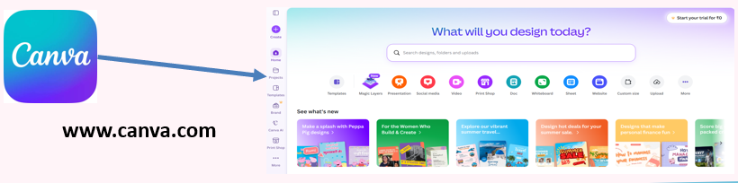
INTRODUCTION TO CANVA
  Canva is an online graphic design platform that helps users create professional-looking designs easily without advanced design skills.
  It offers thousands of ready-made templates for presentations, posters, social media posts, certificates, resumes, brochures, and more.
  Canva uses a simple drag-and-drop interface, making it easy to add text, images, icons, shapes, and other design elements.
  It provides a large library of free and premium resources, including photos, illustrations, videos, audio, fonts, and animations.
  Canva includes AI-powered tools such as Magic Write, Magic Design, Background Remover, and Text-to-Image to speed up the design process.

Slide 48
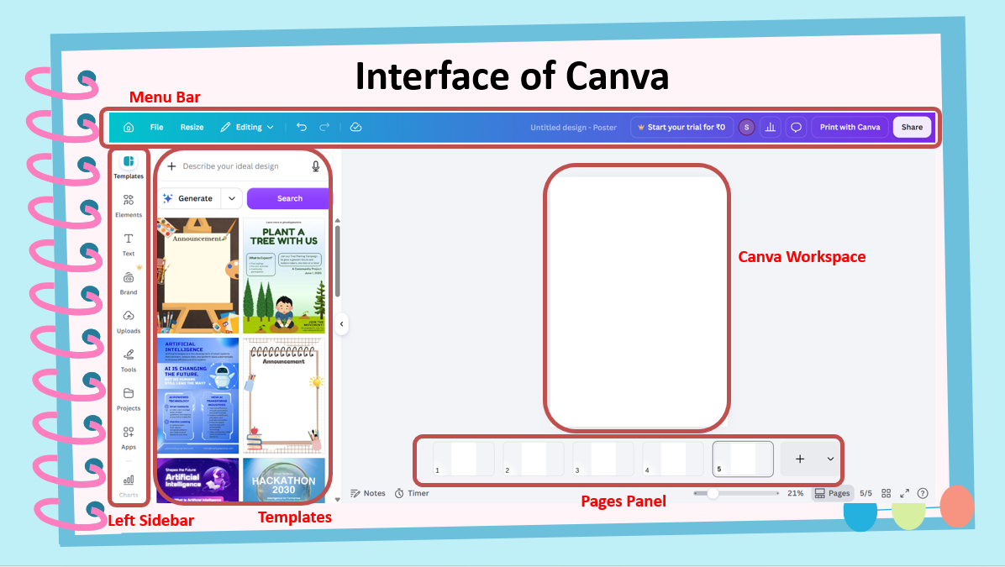

Slide 49
Menu Bar: It located at the top of the screen and provides options such as
File, Resize, Undo, Redo, Share, and Download.
2. Toolbar: It Appears above the design page and contains tools for editing text, changing fonts, colors, alignment, spacing, etc.
3. Left Sidebar: Located on the left side of the screen and gives access to:
  Templates
  Elements
  Text
  Uploads
  Photos & Videos
  Projects
  Apps
  4. Canvas Workspace: The large central area where you create and edit your design. You can add, move, resize, rotate, and arrange design elements here.
5. Pages Panel: It Located below the workspace. And allows you to add, duplicate, delete, or rearrange pages in multi-page designs such as presentations, books, or brochures.

Slide 50


  Magic Media is the AI Tool of Canva
  It is used to create images , graphics and video using text provided by user
  We can get the Magic Media in left side bar and search image generation
Example:
Prompt: A modern computer lab with students learning coding, rows of desktop computers, LED lights, clean environment, realistic photography, high quality, 4K.
ACTIVITY:
Create your own image and used it in the presentation that we will learn In next slide Topic for Image Generation: Renewable Energy

Slide 51
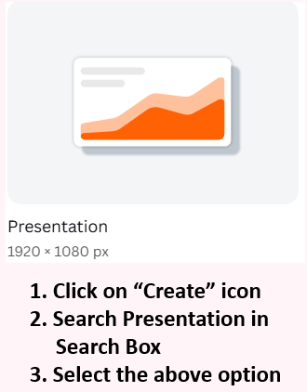
Presentation Generation in Canva
Steps to Generate Presentation in Canva:
  Click on "Create a Design" and choose Presentation or search for a presentation template.
  Select a black ppt Template
  Add Content such as titles, text, images, icons, charts, and graphics on each slide.
  Customize the Design by changing colors, fonts, backgrounds to make the presentation attractive.
  Review the Presentation to check for spelling mistakes, formatting, and slide order.

Slide 52
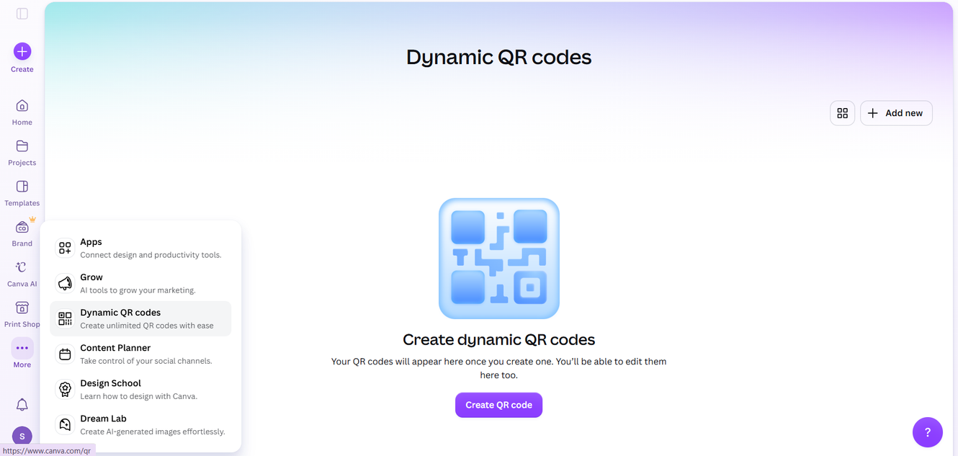
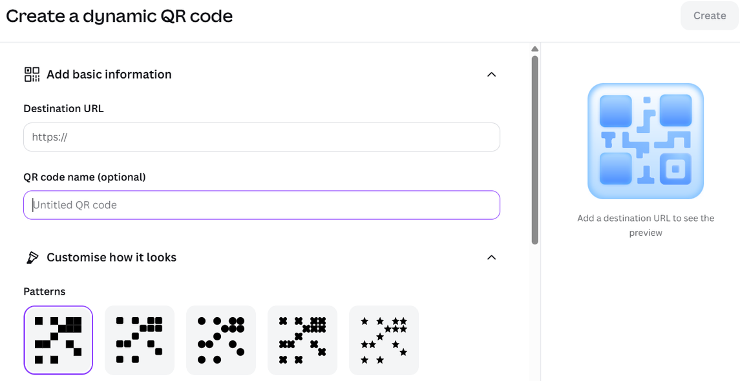
Dynamic QR Code Generation
  QR stands for Quick Response Code.
  It is a 2D barcode that stores information such as website links, contact details, text, Wi-Fi passwords, etc.
  It can be scanned using a smartphone camera or QR scanner.
Steps to Create a Dynamic QR Code:
  Open Canva
  Go to More → Dynamic QR Codes
  Enter the Destination URL
  Give the QR code a Name
  Click Create to generate the QR code

Slide 53

ACTIVITY:
Create the presentation on Renewable Energy and It should look attractive and contain relevant images and content

Slide 54
DONE WITH MODULE 3
ANY DOUBTS ???

Slide 55
CHAPTER 4
Cybersecurity

Slide 56
Introduction to Cybersecurity
  Cyber refers to anything relating to your smart devices like computers and mobiles including information technology, and virtual reality
  Security means protection against danger, damage, or unauthorized access and hacking.
ACTIVITY:
  Why security is required.
  What we can do to secure smart devices
  What will happened if security is low
  Cybersecurity is the practice of protecting networks, devices, software, and sensitive data from digital attacks, unauthorized access, and damage

Slide 57
Fake Links, Phishing & Suspicious Messages
  Fake Link:
A. Fake link is fraud link which may steal your personal information
B. These kind of links doesn’t contain ‘https://’
C. Fake links try to steal your personal data or passwords.
  2. Phishing:
A. Phishing is a type of online scam where attackers send fake
messages or links to trick people into sharing personal information
B. Phishing messages look real but are created by scammers.
C. Never click unknown links from WhatsApp/SMS/email.
D. Always check website URL carefully
Example: “Click here to update your KYC details” → Fake link

Slide 58
Types of Online Messages
Genuine Messages:
A. Sent from trusted and official sources like banks, schools, or known companies.
B. Do not ask for sensitive details like passwords or OTP.
C. Usually have proper spelling, grammar, and official contact details.
D. Example: Rs. xyz amount is debited from your account 89xxxxxx12.
Fake Messages:
A. Sent by scammers or unknown people to cheat users.
B. Often ask for OTP, password, or personal details.
C. Contain urgent or attractive offers like “win prize” or “urgent action required”.
D. Example: Your account is blocked! Share OTP immediately to unlock
ACTIVITY: Safe Or Unsafe:
  Sharing OTP with friend → ___
  Login with password + OTP → ___

Slide 59
Safe Password and account safety
  Use strong passwords with letters, numbers, and symbols.
  Never share your password with anyone.
  Change password regularly for safety.
  Use different passwords for different accounts.
  Example Password: 123456 = Risky Password
S@f3@2026 = Safe Password
Activity : Write Yes or No
  Password: R@huL#2026 → ______
  Password: 123456 → ______
  Using same password for all apps → ______
  Changing password regularly → ______

Slide 60
  Reporting & Responding to Online Fraud
  Block and report suspicious accounts immediately.
  Inform parents or teachers if something looks wrong.
  Use “Report” option on WhatsApp, Instagram, Facebook.
  Save proof like screenshots before deleting.
  Example: Unknown message asking money → Report + Block
  ACTIVITY:
  What is Truecaller
  What is Antivirus with example
  Do you report or block any phone number or website

Slide 61


  Trojan Horse:
  A Trojan Horse is a malware that looks like a safe program.
  It tricks the user into installing it on their system.
  Once installed, it can steal data or give control to hackers.
  It does not spread by itself like a worm.
  Always download software from trusted sources to avoid Trojans.
  Keylogger:
  A keylogger is a software or device that records everything you type.
  Hackers use it to steal passwords, messages, and personal info.
  It works silently in the background without the user knowing.
  Keyloggers can be installed through malware or unsafe downloads.
  Anti-virus and anti-spyware tools help to detect and remove keyloggers.

Slide 62


  Botnet:
  A botnet is a group of infected computers controlled by a hacker.
  Each infected computer is called a "bot“.
  Hackers use botnets to do big cyber attacks like DDoS.
  Users usually don’t know their computer is part of a botnet.
  Antivirus and firewalls help to prevent botnet infections.
DOS Attack:
A DoS (Denial of Service) attack floods a website or server with too much traffic.
The goal is to slow down or crash the system, making it unusable.
It denies service to real users by overloading the system.
It is done using one computer or source.
Firewalls and monitoring tools help to detect and block DoS attacks.

Slide 63

  DDOS Attack:
  A DDoS (Distributed Denial of Service) attack uses multiple computers to flood a server or website.
  These computers are often part of a botnet controlled by a hacker.
  It makes the system crash or become very slow.
  It is stronger than a normal DoS attack because it comes from many sources.
  DDoS attacks are hard to stop and need advanced security tools.

Slide 64
DONE WITH MODULE 4
ANY DOUBTS ???

